Slide 1


ANALYSIS & 3D-PROTOTYPING OF A
HUMAN HUMER BONE
Batch Number : MEK6212211
Under the supervision of
Mr. T N V Ashok Kumar
Assistant Professor
Presented by
N. Chandra Sekhar (19K65A0347)
S. JaiKanth (19K65A0364)
M. Gowtham (19K65A0378)
Verified by:
Project Supervisor with Date & Time:
Project Coordinator with Date & Time:
HOD with Date & Time:
Department of Mechanical Engineering

Slide 2
CONTENTS
Abstract
Introduction
Literature Review
Problem Identification
Objective of the Project
Methodology
Static Analysis
Result
Conclusion
Future Scope
References

Slide 3
1. Abstract
The project founds the best suitable material for Human Bone implant by evaluating specific properties of the material. The Material properties are evaluated by using Ansys Workbench software and the prototype model is created by using Rapid Prototyping technique.

Slide 4
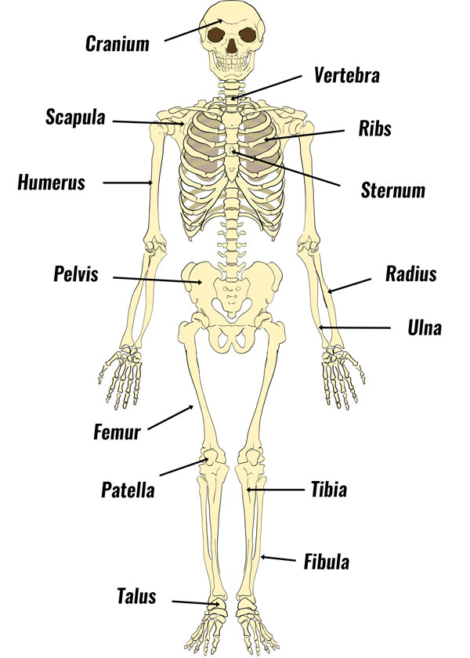
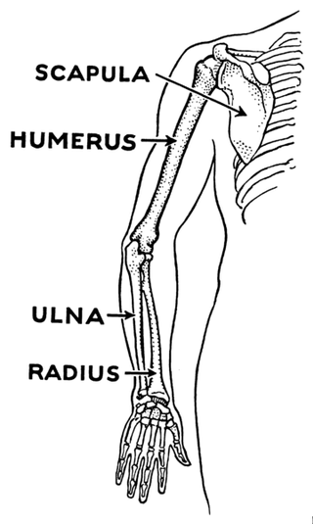
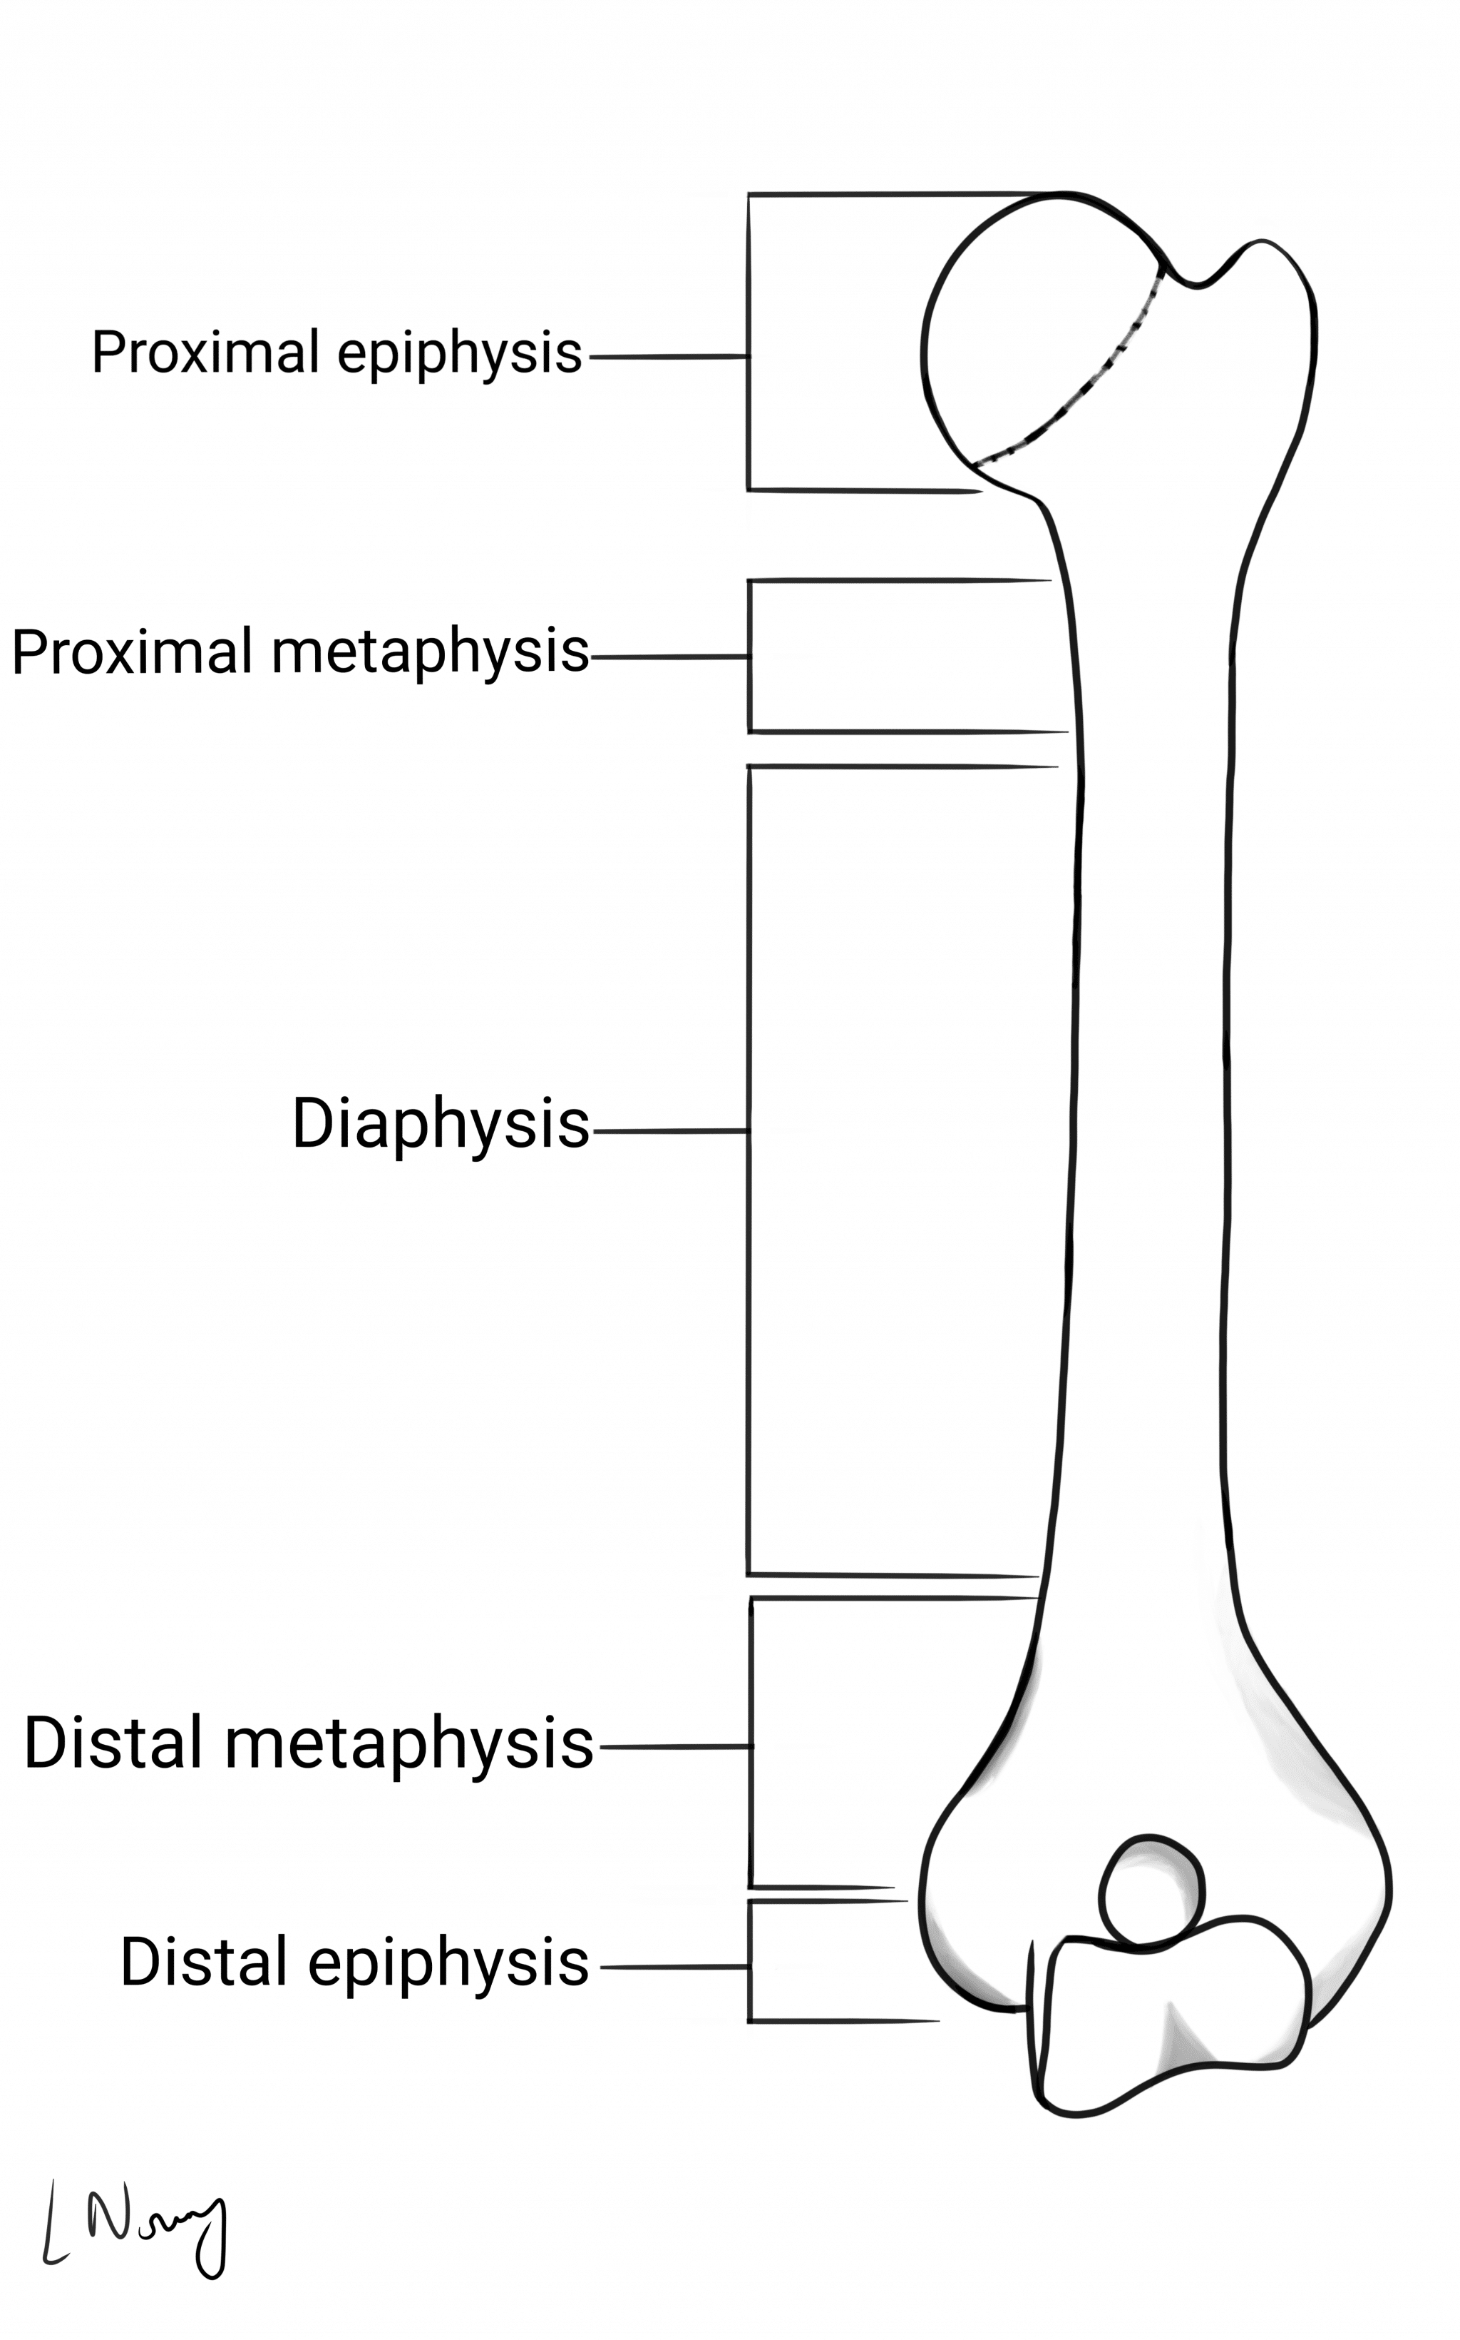
2. Introduction
HUMER BONE
Humer bone is the longest and thickest bone of the upper extremity.
It is a long bone that runs from the shoulder & Scapula (shoulder blade) to the elbow.
Fig. 1. Humer Bone
Fig. 2. Skelton System

Slide 5
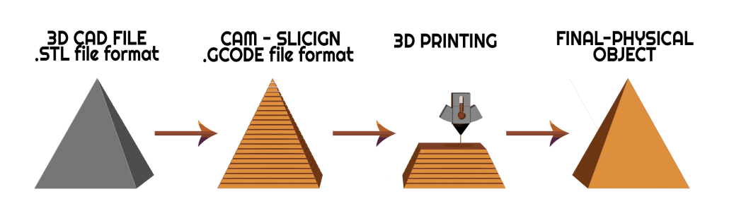
Rapid Prototyping Technique (RP)
ANALYSIS
Begin
Open ANSYS WORKBENCH
Use static system
Apply Loads
Meshing
Define Material used
Import Solidwork Model
End

Slide 6
3. Literature Review
S.No. | Paper Details | Contents in the Paper
1 | Jennie Walker, System of Life Skeletal System, Nursing Time [online], Research Article, February 2020. | This article tells about the bone is important part of musculoskeletal system and serve many core functions, as well as supports the entire body.
2 | AYDIN KABAKCI, et. al, International Journal of Morphology, an osteometric study on humerus bones, October 2017. | In this journal, morphometric measurements were classified into three groups such as proximal epiphysis, humerus diaphysis and distal epiphysis of humerus. Mean, minimum, maximum and standard deviation values of all parameters were determined.
3 | RYAN TROMBETTA, et. Al, 3D Printing of Calcium Phosphate Ceramics for Bone Tissue Engineering and Drug Delivery. Research gate journal June 2016. | The journal gives information about various materials and methods which are appropriate for creating a human bone using 3-D printing.

Slide 7
S.No. | Paper Details | Contents in the Paper
4 | Shivraj Yeole [Doctor of Philosophy] Research Gate Journal December 2015. | This paper discuss about the process of 3D scanning, data processing and CAD modelling of humerus bone in CATIA software and described.
5 | Orthopaedics&Traumatology: Surgery & Research Volume 102, Issue 7 November 2016. | This article describes about application of 3D printing technology on treatment of complex proximal HUMERAL fractures in old people.
6 | Additive Manufacturing Published by Science Direct journal & books, Volume 33 May 2020. | This article describes Additive manufacturing of fracture fixation implants: Design, material characterization, biomechanical modeling and experimentation.

Slide 8
S.No. | Paper Details | Contents in the Paper
7 | S.Lokanadham.,“Morphometric analysis of humerus bone in Indian population,” Sch. J. App. Med. Sci., 2013. | This article tells about using the available tools in CATIA software, the point clouds are reduced so as to obtain a surface model which is then converted to a solid model.
8 | Rahul Manohar Sherekar et al., “Manufacturing & biomechanical analysis of a human shoulder joint: a methodology review,” Am. J. Mech. Eng. Atom., 2014 | This article describes about 3D model can be used to perform analysis for knowing the behavior. Also it can be used for obtaining 3D printed prototype of human humerus bone.
9 | Leonardo Frizziero, Giampiero Donnici, New Methodology for Diagnosis of Orthopedic Diseases through Additive Manufacturing Models. 7 March 2019. | This article tells about femur bone is modeled and analyzed with four different materials. Out of these materials used Ti-6Al-4V & PLA is found out to have less equivalent stress & corrosion and wear resistance of the materials.

Slide 9
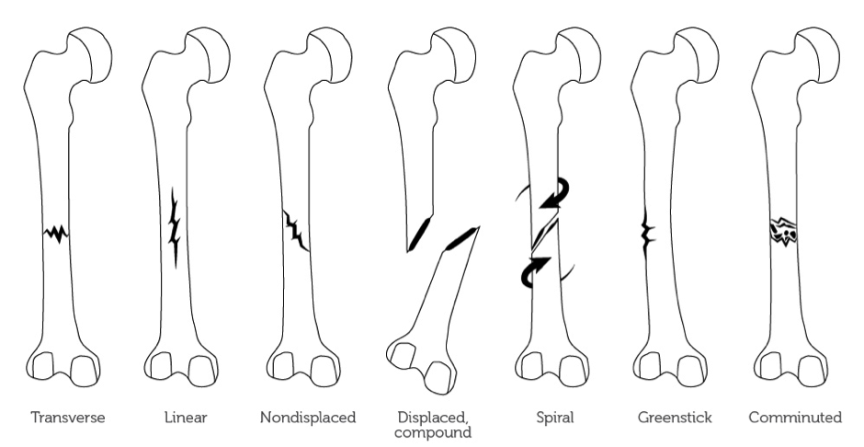
4. Problem Identification
Types of Forces acting on Humer:
Compressive
Point
Shear
Impact
Vibration

Slide 10
5. Objective of the Project Work
ANALYSIS
To determine Materials used for Bone Implant.
To identify various loads acting on the Bone.
To select best material for Bone Implant.
3D- PRINTING
To identify the best suitable 3D-Printing process for Bone prototype and Manufacturing using such process.

Slide 11
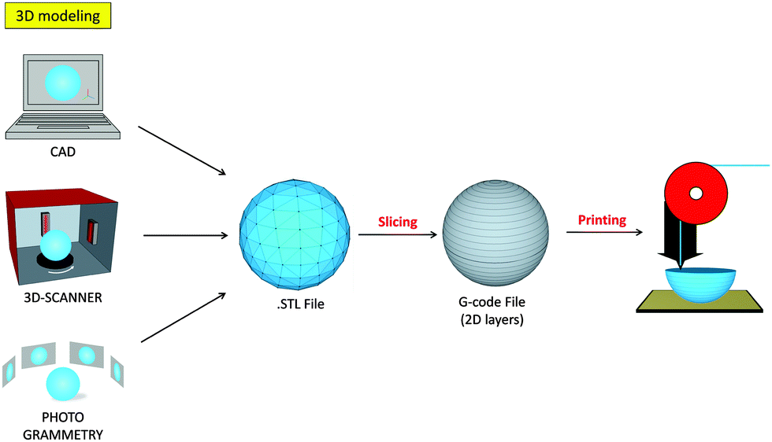
6. Methodology
3D SCANNING
DATA PROCESSING
CAD MODELLING
Fig. 3 Methodology

Slide 12
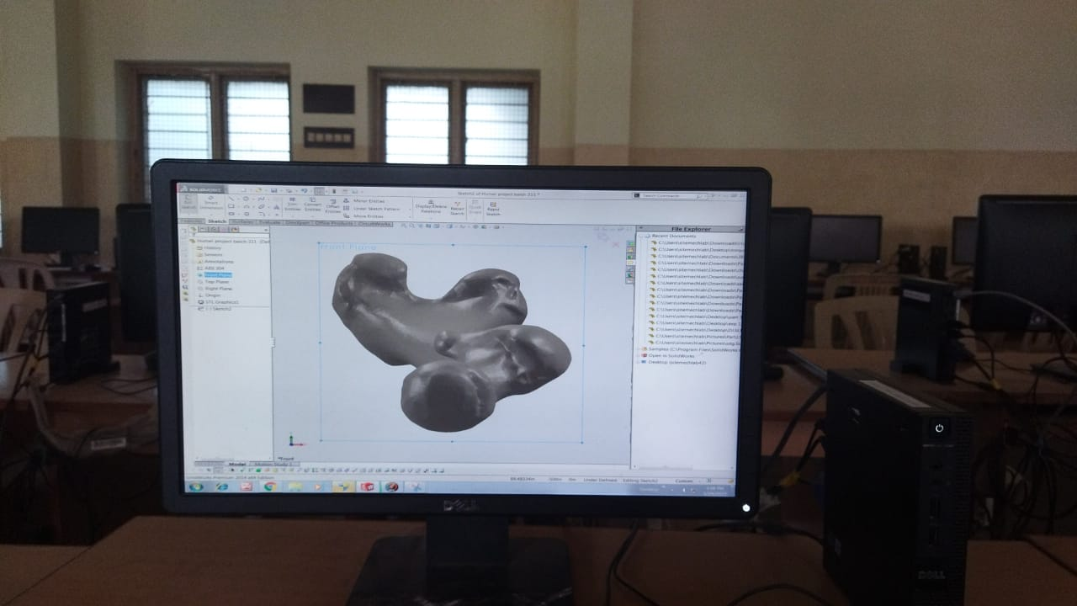
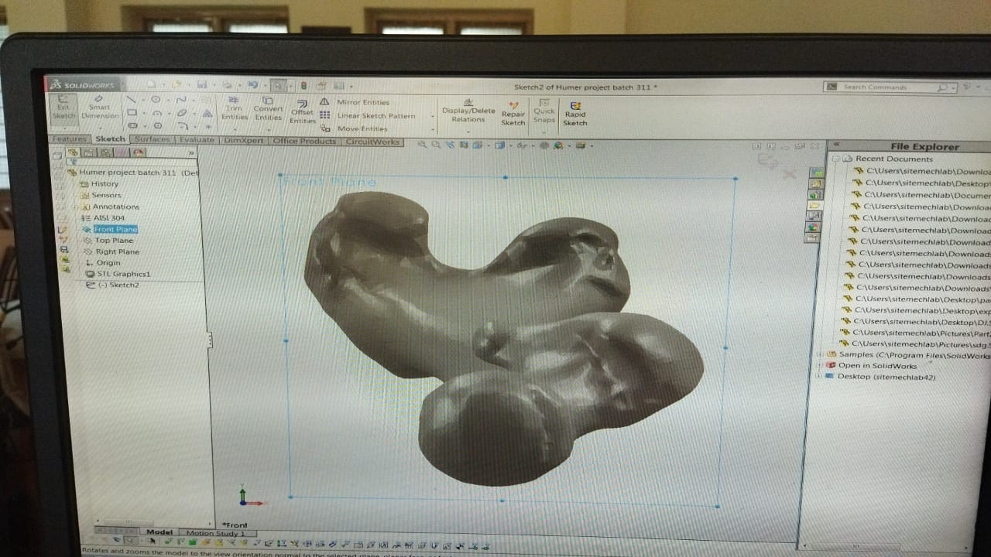
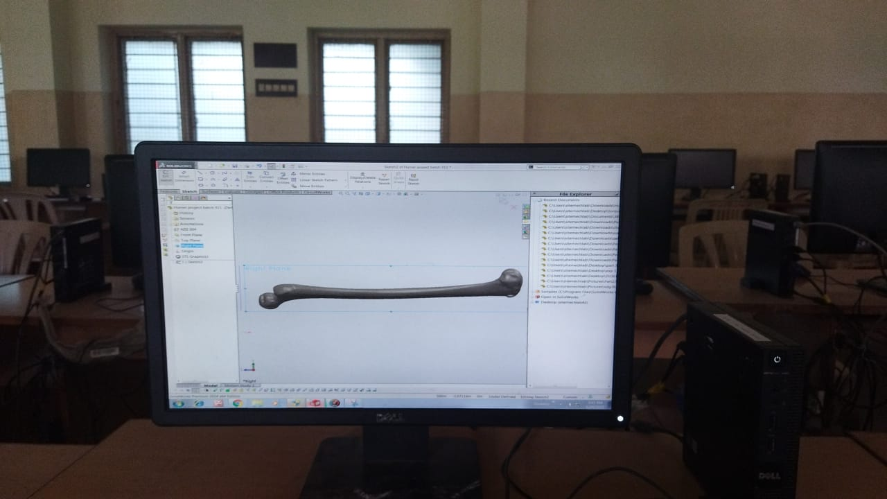
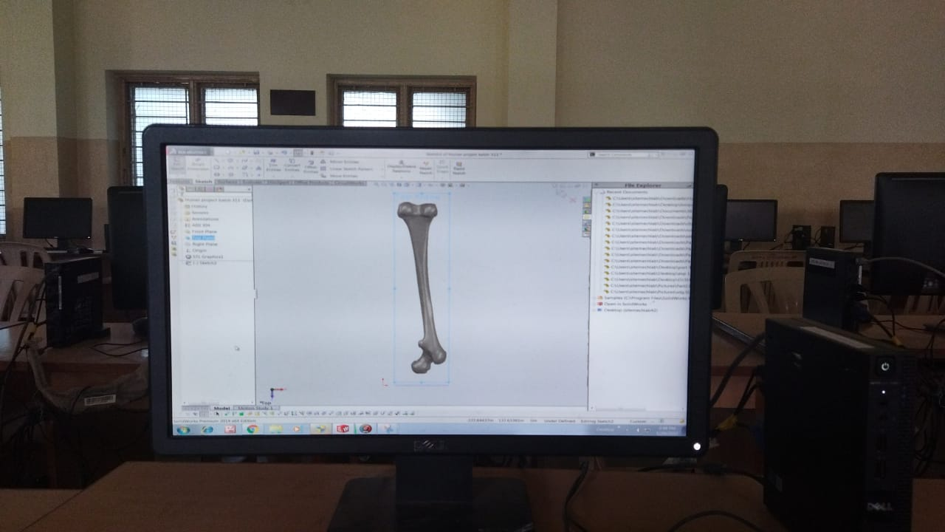
CAD Model
Modeling Software- SOLIDWORKS
Fig. 4. Front Plane View
Fig. 5. Front Plane View
Fig. 6. Right Plane View
Fig. 7. Top Plane View

Slide 13
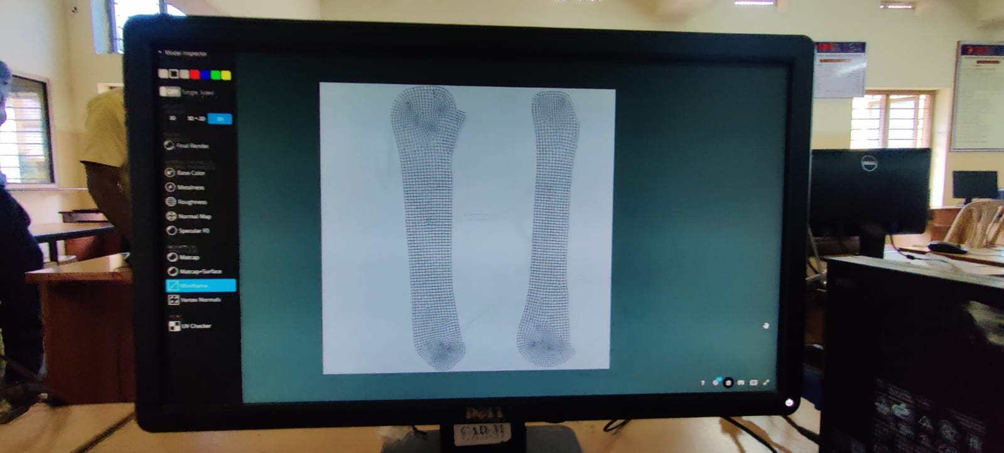
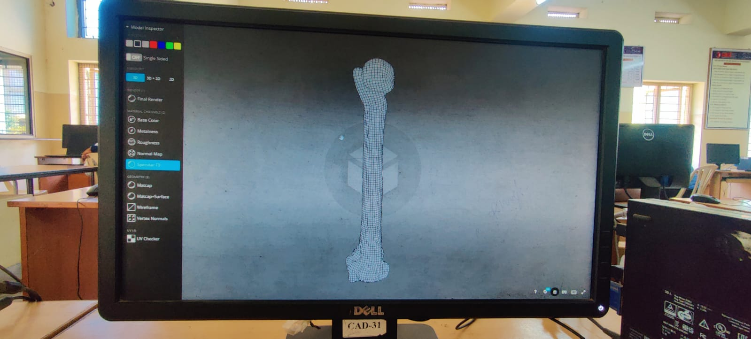
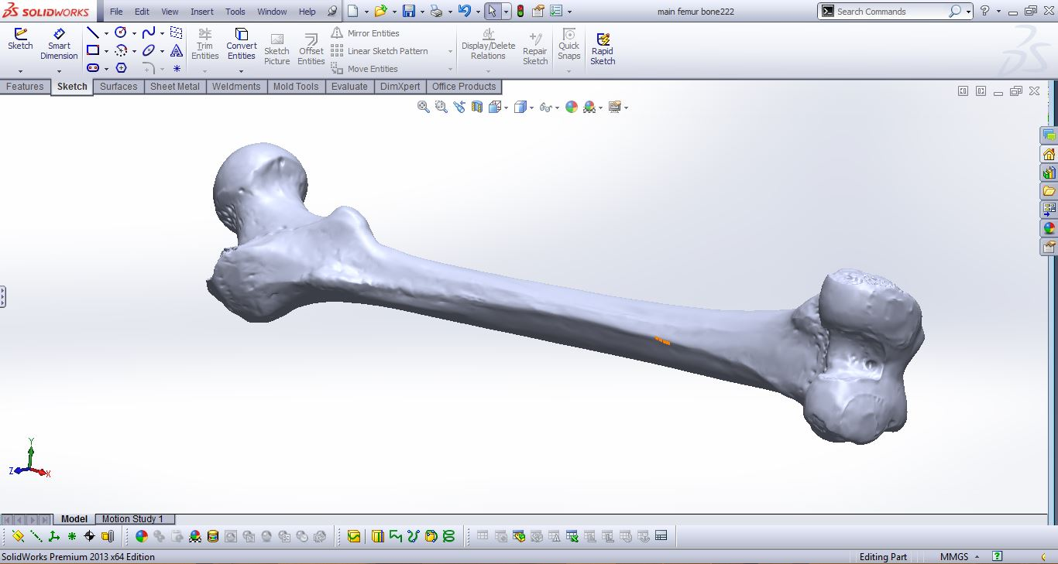
Fig. 8. 2D View of Humer Bone
Fig. 9. 3D View of Humer Bone
Fig. 10. Humer Bone Model Using Solidworks Software

Slide 14
Tools in Solidworks
For designing humer bone the following tools are used
Sketcher Tools
Extrude
Revolve
Cut Extrude
Mirror
Selection Of Material
Move
Rotate
Mate

Slide 15
Material Selection
As per study there are some materials that Human Body tissues accepts with it.
Steel 304
Ti-6Al-4V
Calcium Phosphate
Strontium
PLA
S. No | Material | E (Mpa) | (µ)
1 | Steel 304 | 193 | 0. 3
2 | Ti-6Al-4V | 110 | 0. 3
3 | Strontium | 157 | 0. 28
4 | Calcium Phosphate | 105 | 0. 27
5 | PLA | 3100 | 0. 29
Material Properties Table

Slide 16
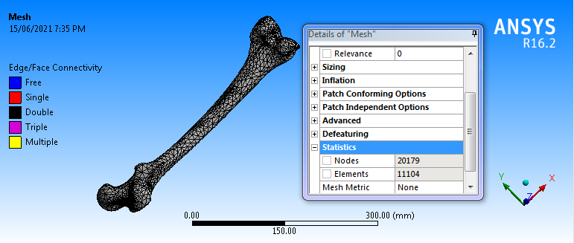
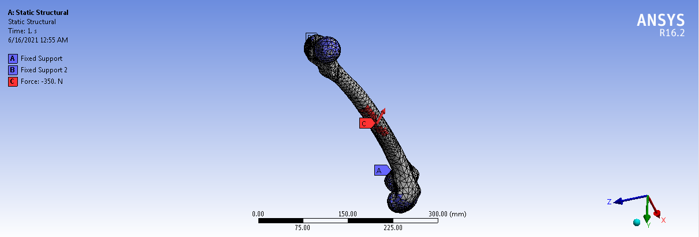
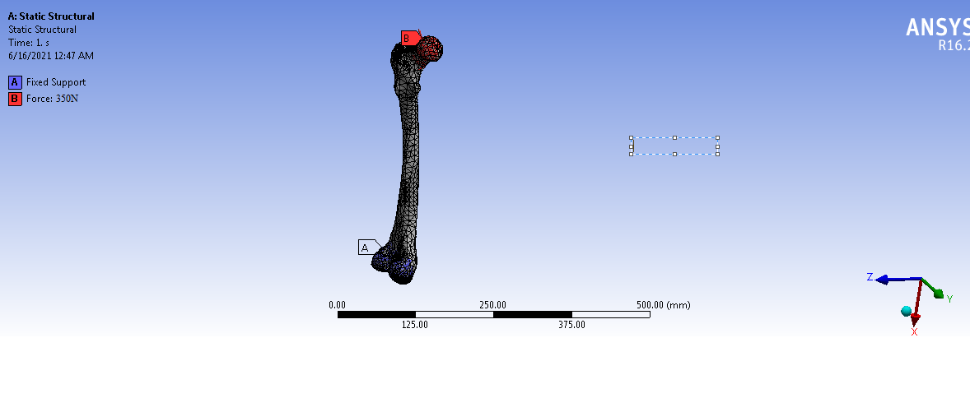
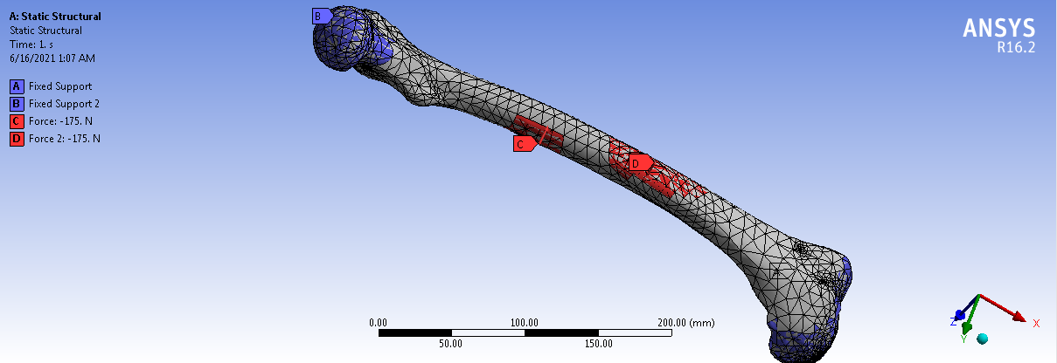
7. Static Analysis The following load conditions are consider during static analysis
Fig. 11. Mesh Nodes: 20179, Elements: 11104
Fig. 12. Point Load 390N
Fig. 13. Compressive Load 390N
Fig. 14. Shear Load 390N

Slide 17
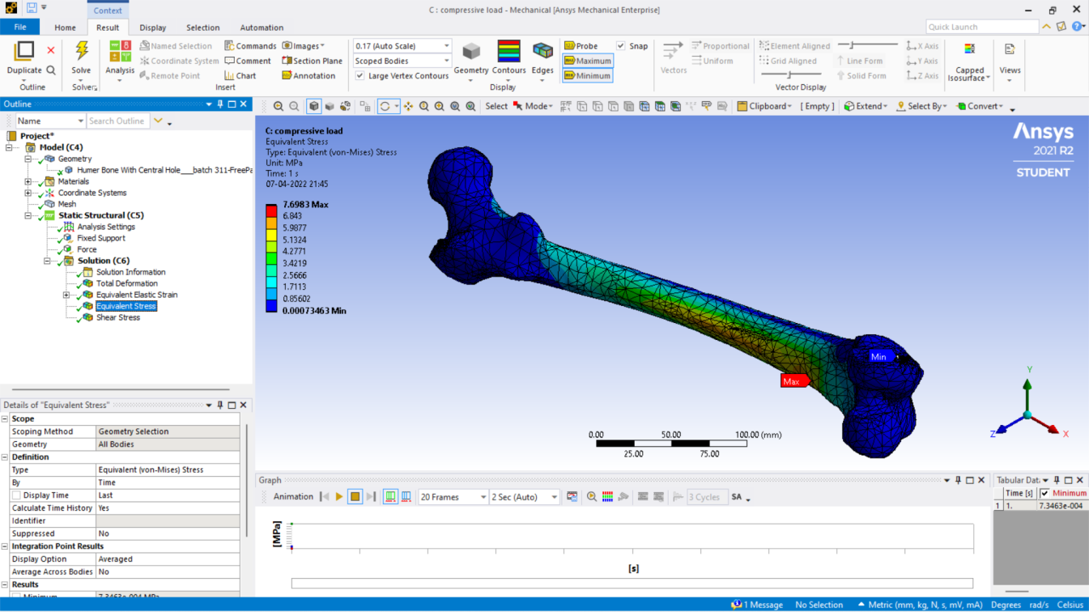

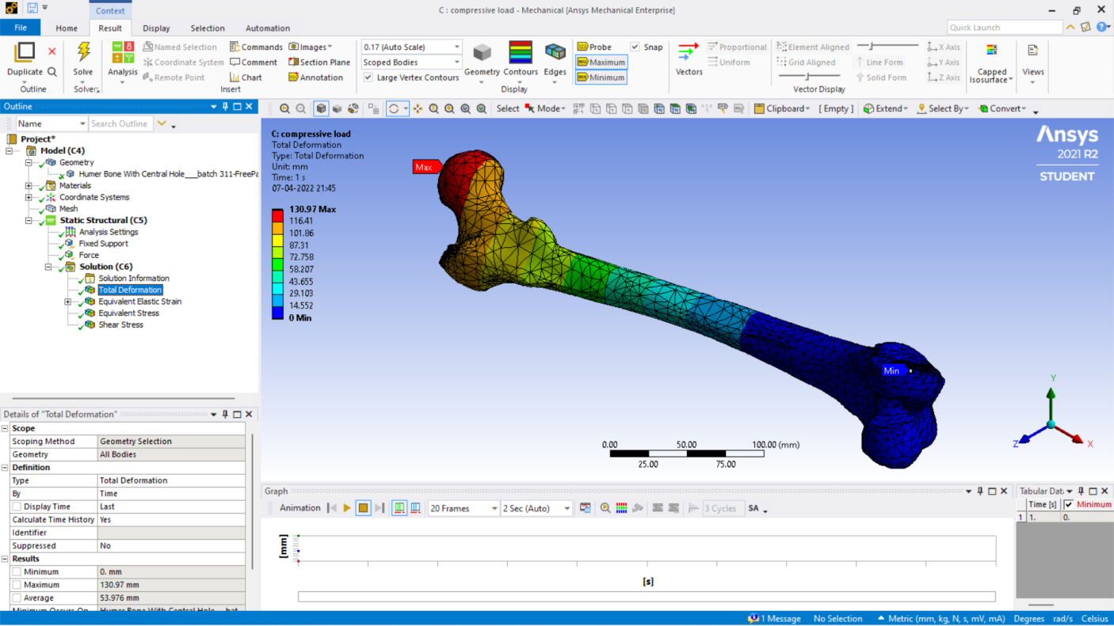
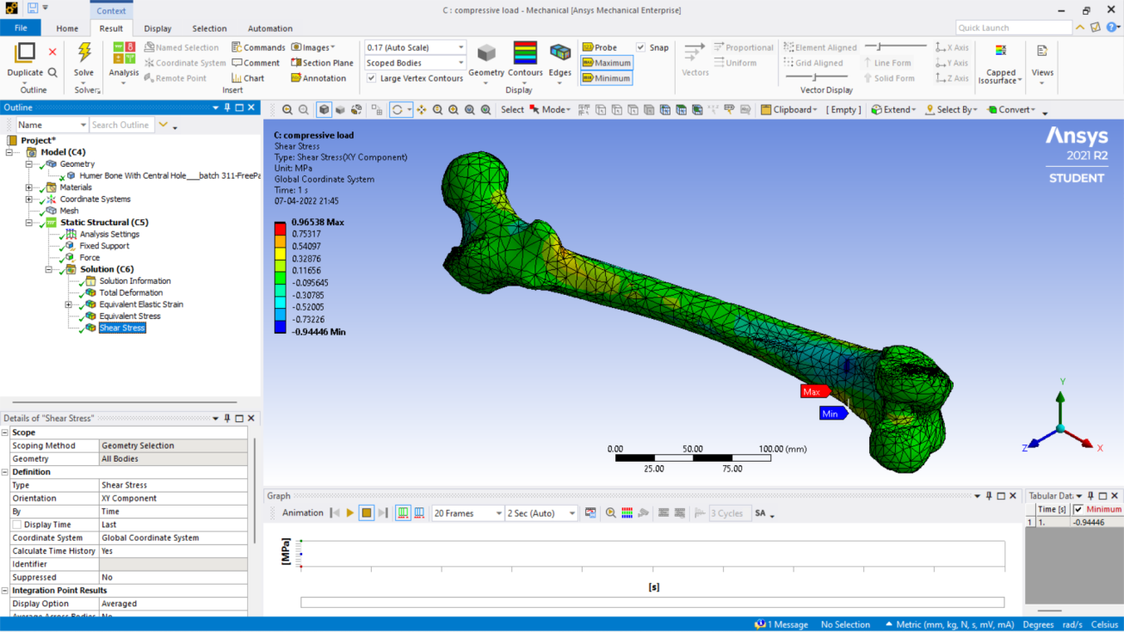
Compressive Load Compression load applying on Ti-6Al-4V
Fig. 15. Von-misses stress
Fig. 16. Strain
Fig. 17. Total Deformation
Fig. 18. Shear Stress

Slide 18
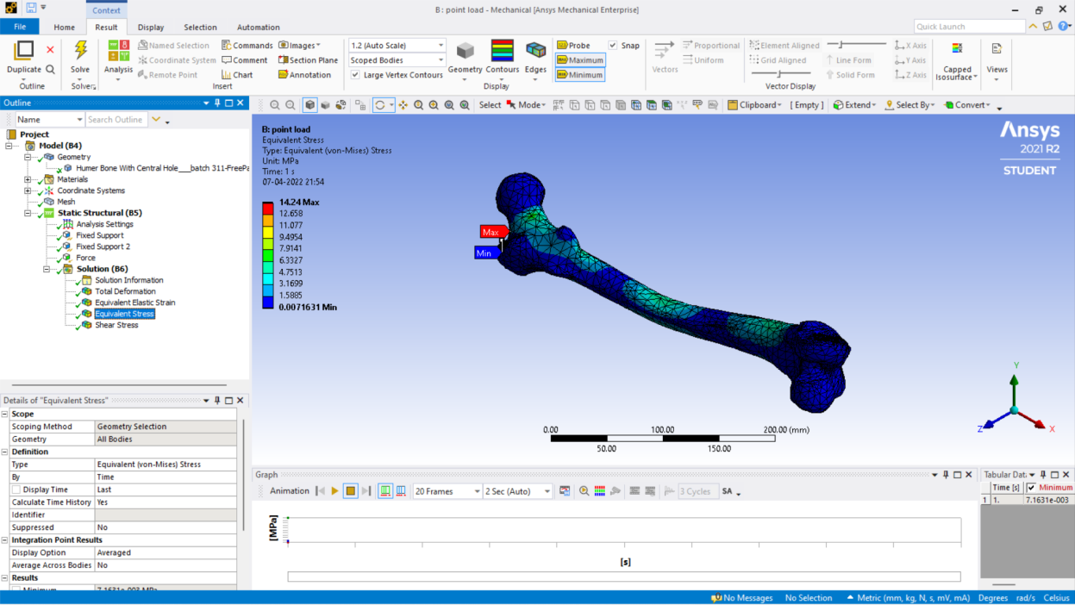
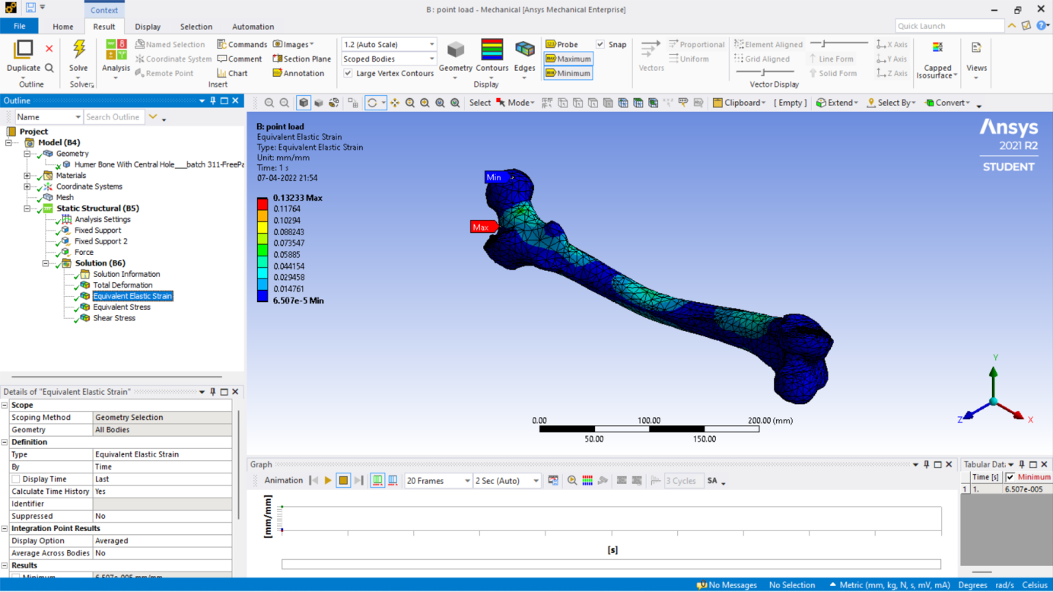
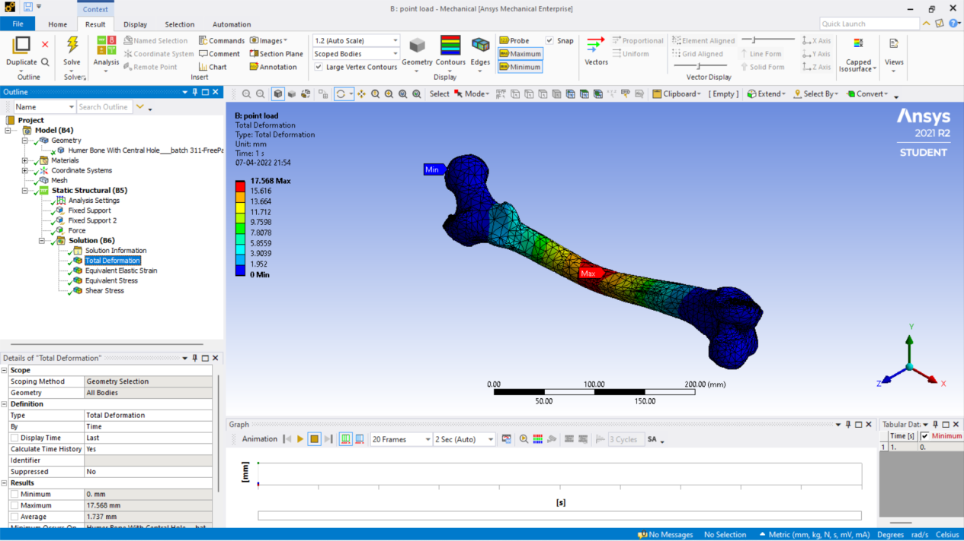
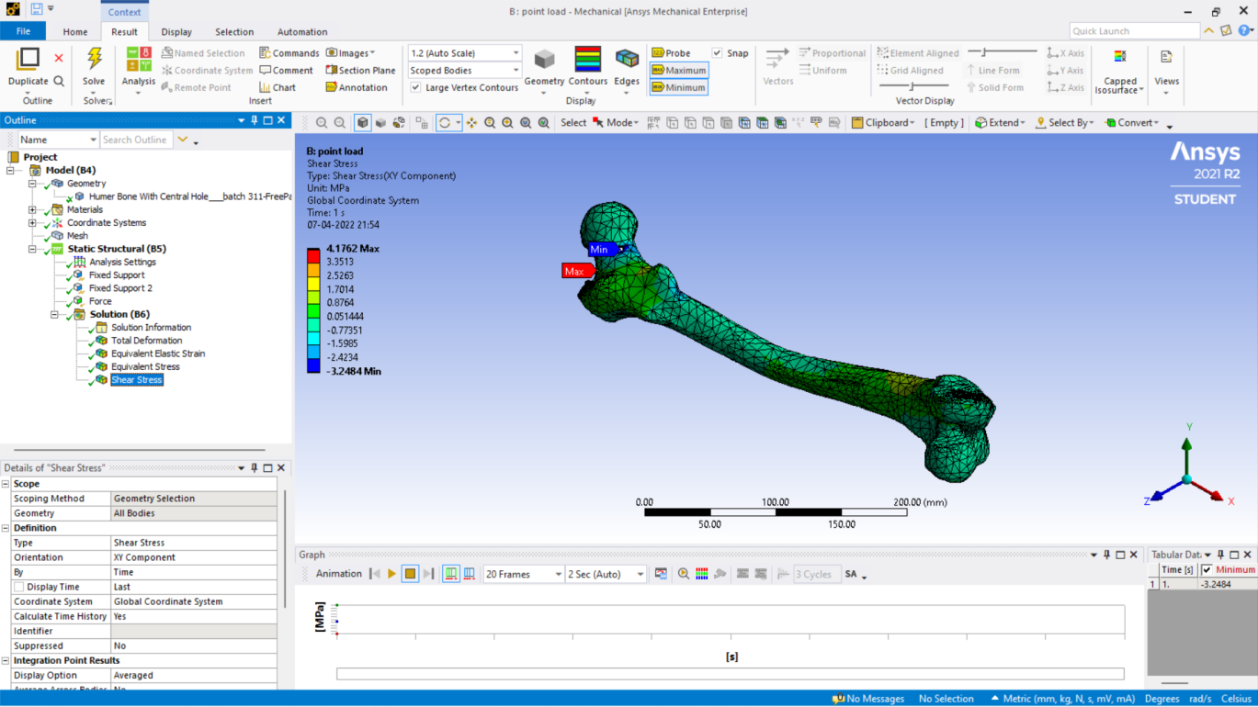
Point Load Point load applying on Ti-6Al-4V
Fig. 19. Von-misses stress
Fig. 20. Strain
Fig. 21. Total Deformation
Fig. 22. Shear Stress

Slide 19
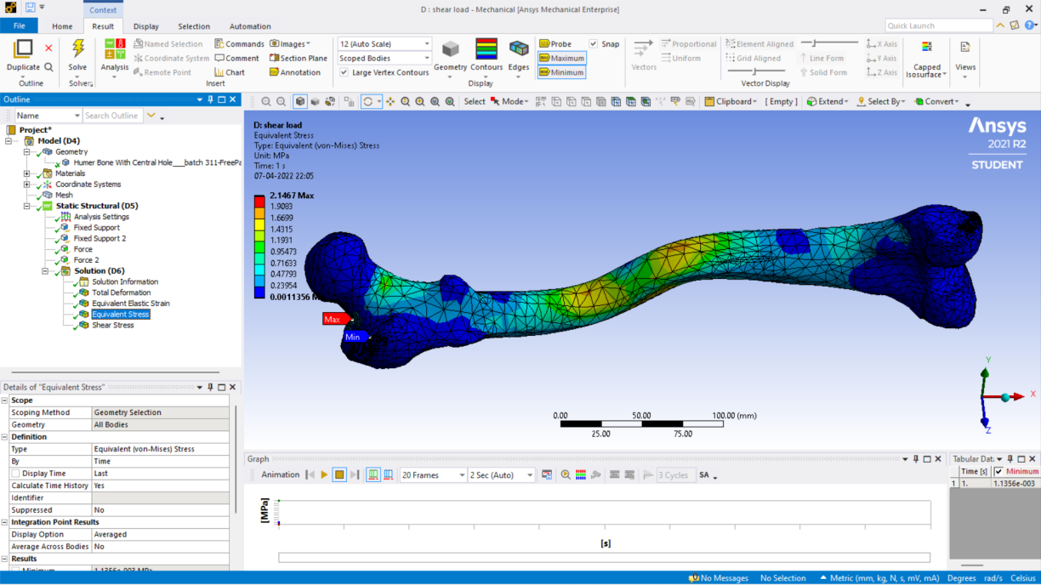


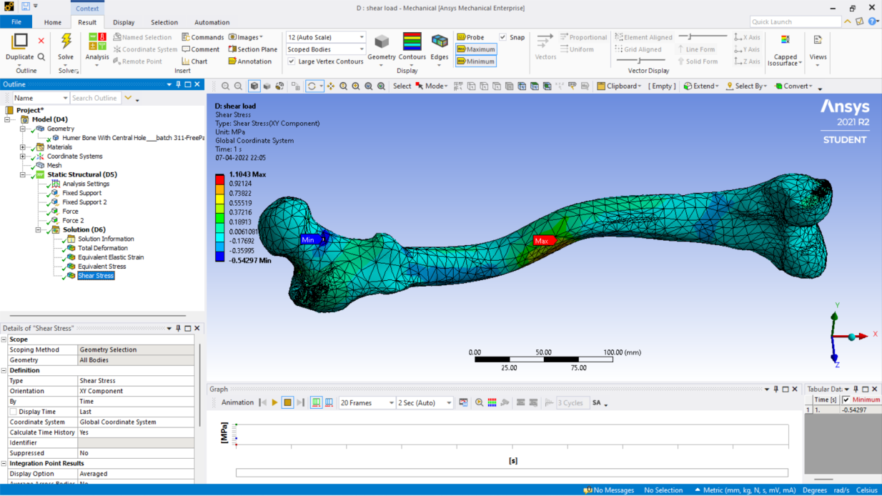
Shear Load Shear load applying on Ti-6Al-4V
Fig. 23. Von-misses stress
Fig. 24. Strain
Fig. 25. Total Deformation
Fig. 26. Shear Stress

Slide 20
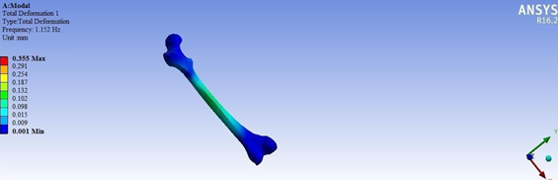
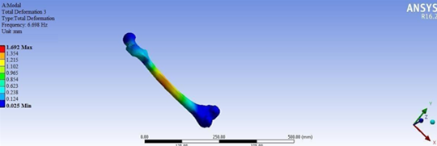
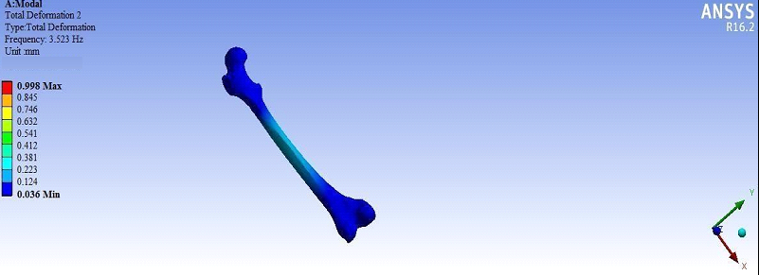
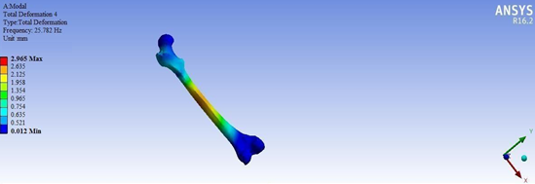
Modal Analysis
For Ti-6Al-4V
Fig. 27. Mode 1
Fig. 29. Mode 3
Fig. 28. Mode 2
Fig. 30. Mode 4

Slide 21
8. Results
Static Structural Analysis
Compressive Load at 390N:
 | Ti-6Al-4V | Steel 304 | Strontium | Calcium Phosphate | PLA
Vom-misses stress (Mpa) | 7. 69 | 7. 89 | 8. 561 | 8. 571 | 8. 55
Total Deformation (mm) | 130. 9 | 109. 1 | 134. 31 | 200. 83 | 6. 8
Strain | 0. 064 | 0. 044 | 0. 054 | 0. 081 | 0. 002
Shear Stress (Mpa) | 0. 96 | 1. 1 | 1. 16 | 1.17 | 1. 169

Slide 22
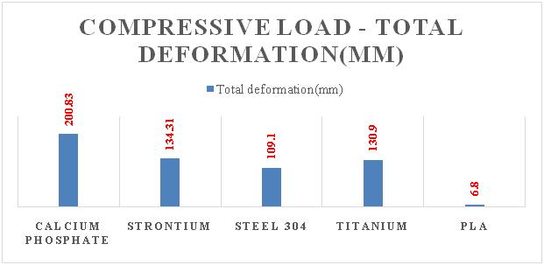
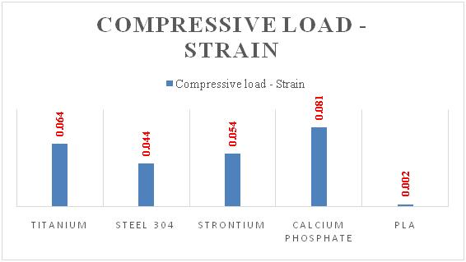
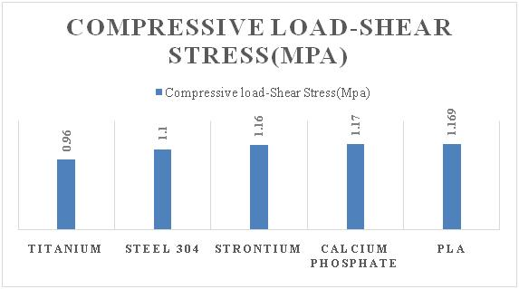
Compressive Load at 390N
Fig. 1Von-misses stress Graph of Compressive load
Fig.2 Total deformation Graph of Compressive load
Fig. 3 Strain Graph of Compressive load
Fig 4 Shear stress Graph of Compressive load

Slide 23
Point Load at 390N:
 | Ti-6Al-4V | Steel 304 | Strontium | Calcium Phosphate | PLA
Vom-misses stress (Mpa) | 14. 02 | 14. 02 | 14. 13 | 14. 07 | 14. 18
Total Deformation (mm) | 11. 2 | 10. 83 | 13. 29 | 19. 86 | 12. 02
Strain | 0. 09 | 0. 08 | 0. 092 | 0. 14 | 0. 1
Shear Stress (Mpa) | 4. 11 | 4. 12 | 4. 13 | 4. 18 | 4. 16
Shear Load at 390N:
 | Ti-6Al-4V | Steel 304 | Strontium | Calcium Phosphate | PLA
Vom- misses stress (Mpa) | 2. 14 | 2. 14 | 2. 15 | 2. 145 | 2. 141
Total Deformation (mm) | 1. 08 | 1. 1 | 1. 42 | 2. 12 | 19
Strain | 0. 011 | 0. 01 | 0. 021 | 0. 02 | 0. 022
Shear Stress (Mpa) | 1. 105 | 1. 104 | 1. 11 | 1. 114 | 1. 106

Slide 24
Point Load at 390N
Fig. 5 Von-misses stress Graph of Tensile load
Fig. 6 Total deformation Graph of Tensile load
Fig.7 Strain Graph of Tensile load
Fig.8 Shear stress Graph of Tensile load

Slide 25
Shear Load at 390N
Fig. 9 Von-misses stress Graph of Shear load
Fig. 10 Total deformation Graph of Shear load
Fig. 11 Strain Graph of Shear load
Fig. 12 Shear stress Graph of Shear load

Slide 26
Modal Analysis
Frequency:
 | Ti-6Al-4V (Hz) | Steel 304 (Hz) | Strontium (Hz) | Calcium Phosphate (Hz) | PLA (Hz)
Mode 1 | 1.152 | 1.235 | 1.123 | 1.102 | 0.965
Mode 2 | 3.532 | 3.653 | 3.542 | 3.321 | 3.125
Mode 3 | 6.698 | 6.951 | 6.532 | 6.251 | 6.123
Mode 4 | 25.782 | 26.128 | 24.68 | 23.62 | 23.654
Total Deformation:
 | Ti-6Al-4V (mm) | Steel 304 (mm) | Strontium (mm) | Calcium Phosphate (mm) | PLA (mm)
Mode 1 | 0.355 | 0.235 | 0.632 | 0.782 | 0.793
Mode 2 | 0.998 | 0.965 | 1.253 | 1.362 | 1.456
Mode 3 | 1.692 | 1.652 | 1.965 | 2.361 | 2.536
Mode 4 | 2.96 | 2.63 | 3.15 | 3.351 | 3.56

Slide 27
Frequency

Slide 28
Total Deformation

Slide 29
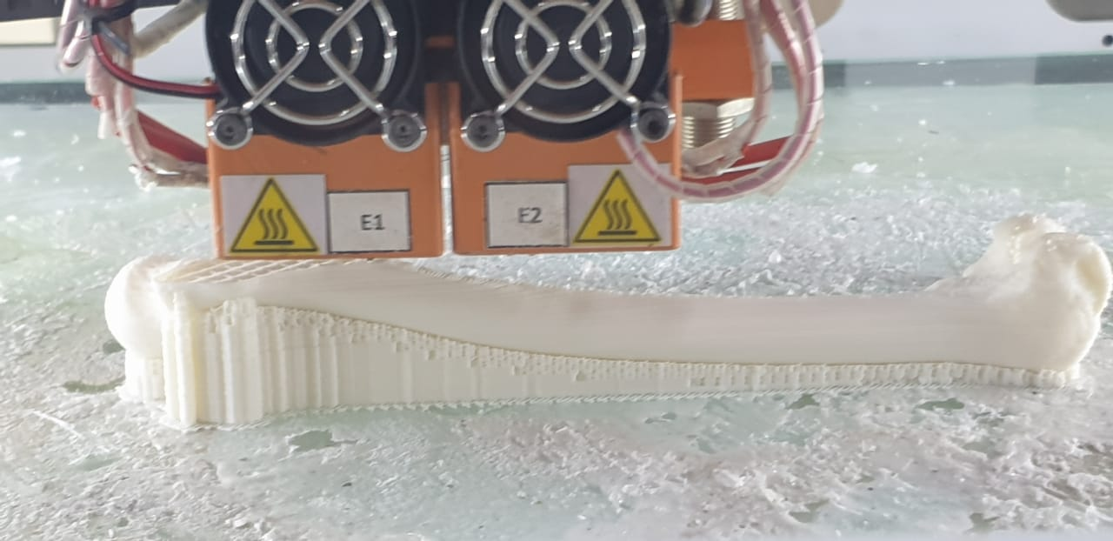
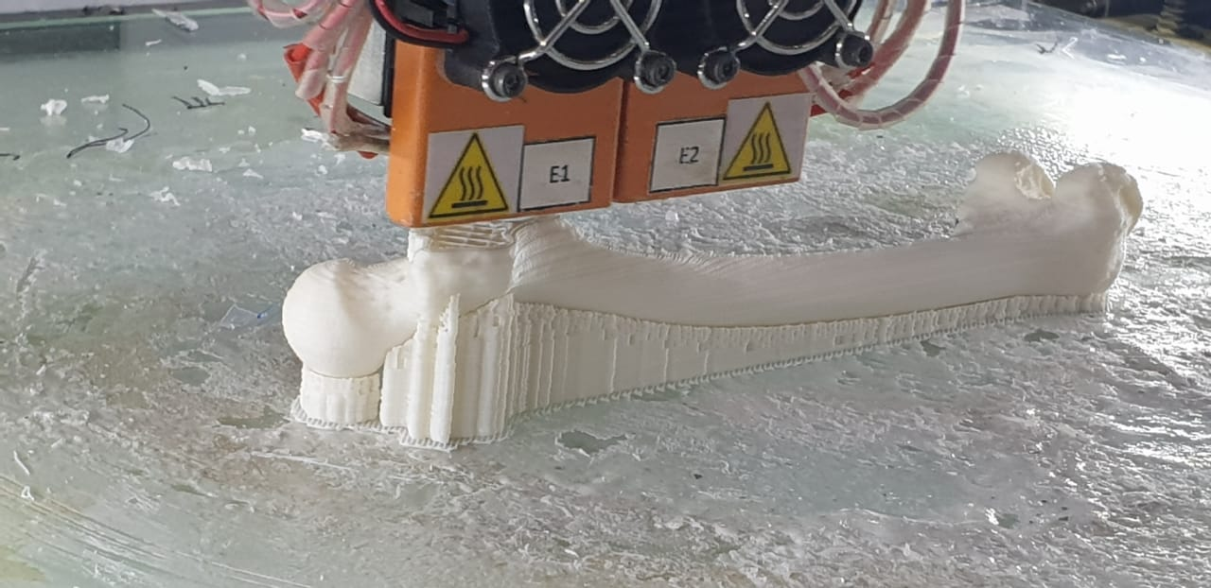
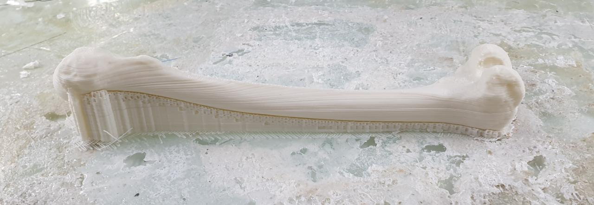
Rapid Prototyping
Using FDM method.
Fig. 31.Rapid Prototyping
Fig. 32. Humer bone Produced with FDM method

Slide 30
9. Conclusion
To conclude, There are only three different materials that can be used for Bone Transplantation.
In the case of Femur Bone Implant, Ti-6Al-4V will be the best material for bearing different types of loads that occur. Because, for Compressive Load Ti-6Al-4V’s Vom-misses stress is 7.69 Mpa, Total Deformation is 130.90mm, Strain is 0.064, and Shear Stress is 0.96 Mpa.
As, Ti-6Al-4V metal is very expensive we can replace it with Stainless steel 304. Because, With the result identified in this project for Ti-6Al-4V and Stainless steel are almost near.
By Using Rapid Prototyping Technique prototype Bone is manufactured.

Slide 31
10. Future Scope
With the help of Selective Laser Sintering Process Ti-6Al-4V metal Femur bone can be manufactured.
The Human Bone Transplantation becomes uncomplicated.

Slide 32
11. References
Jennie Walker, Nursing Time [online], Research Article, February 2020.
Ayden Kabakci, Buyukmumcu, Wilma, Cicekcibasi, Akin & Chan, International Journal of Morphology, an osteometric study on humerus bones, October 2017.
3) Ryan Trombetta, Jason A. Inzana, 3D Printing of Calcium Phosphate Ceramics for Bone Tissue Engineering and Drug Delivery, Research gate journal, June 2016.
4) Shivraj Yeole[Doctor of Philosophy], Research Gate Journal, December 2015.
5) Orthopedics & Traumatology: Surgery & Research. Volume 102, Issue 7, November 2016.
6) S. Lokanadham., “Morphometric analysis of humerus bone in Indian population,” Sch. J. App. Med. Sci., 2013.

Slide 33
7) Rahul Manohar Sherekar et al., “Manufacturing & biomechanical analysis of a human shoulder joint: a methodology review,” Am. J. Mech. Eng. Atom., 2014.
8) Additive Manufacturing, Published by Science Direct journal & books, Volume 33 May 2020.
Leonardo Frizziero, Giampiero Donnici, New Methodology for Diagnosis of Orthopedic Diseases through Additive Manufacturing Models. 7 March 2019.
Auricchio, F.;Marconi, S. 3D printing: Clinical applications in orthopedics and traumatology. EFORT Open Rev. 2016, 1, 121–127.

Slide 34


